Slide 1
CRYPTO TRADING BOT
Roberto García, Gonzalo Etse, Habib Aminu

Slide 2
Mission
Crypto is for enthusiastics, for people who follow their passions and do not let this world setbacks overcome them.
For this reason, it should be really taken into account this niche-sector opinions by mass-extracting and analyzing them, correlating them with crypto prices.
By doing this, new project trends, visions and focus-changes can be anticipated, and investments can be fostered where they can be made the most out of.
https://github.com/Robson-55/Crypto_Trading_Bot

Slide 3
Project Definition
→ Establishing an Automated Investment Fund in Enzyme platform
→ Performing sentiment analysis and prediction of future prices

Slide 4
Data Extraction
→ Scrapping market data from certain cryptocurrencies
→ Scrapping past Reddit messages related to those cryptocurrencies
→ Scrapping recent news from Cryptopanic (Reddit, Twitter…)

Slide 5
Development - Phase 1 (sentiments)
→ Scrapping from Reddit the last reddits from certain cryptocurrencies
→ Give a correct format to the resulting dataframe obtained
→ Pass the dataframe of reddits through GPT-2 in order to perform sentiment analysis and transform them into scores (0-negative, 1-positive). Take 15 scores per day.
→ The obtained dataframe will be called “X”

Slide 6
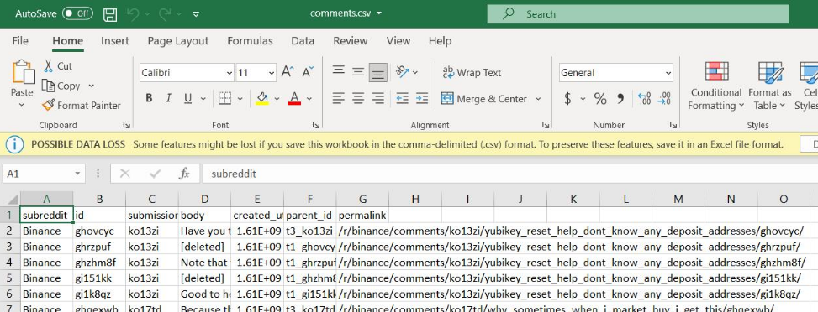
Reddit Scrapping

Slide 7
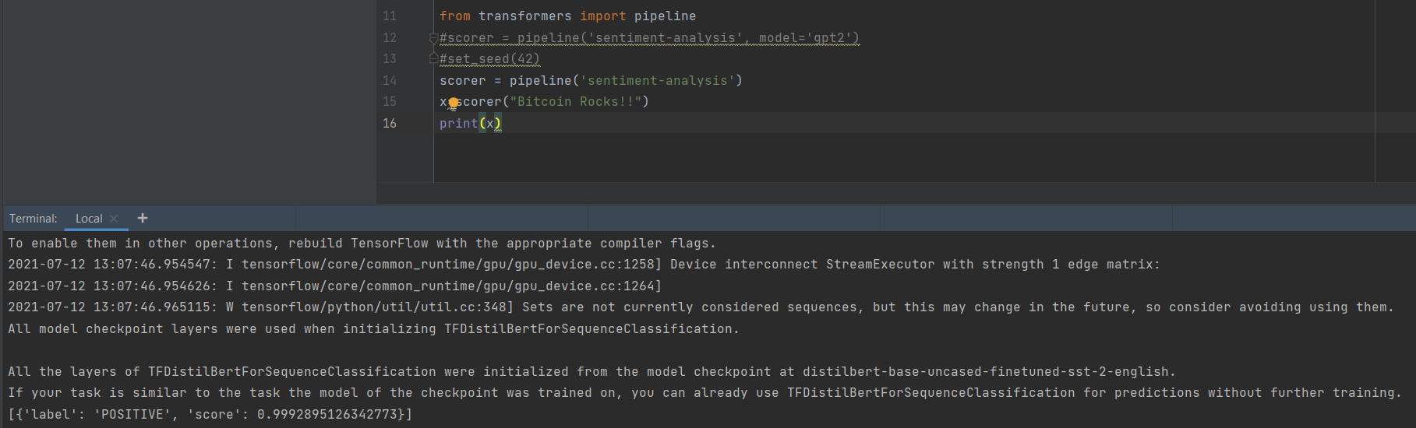
GPT-2 : Sentiment Analysis

Slide 8
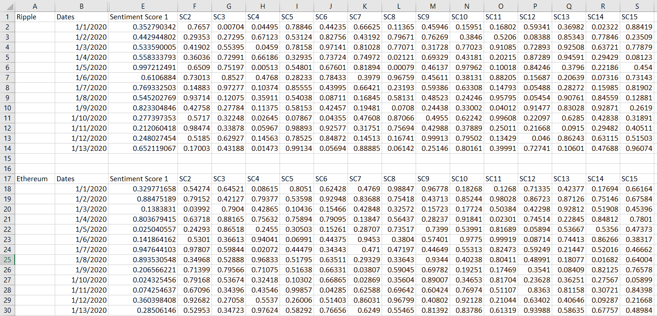
GPT-2 : Sentiment Analysis

Slide 9
Development - Phase 2 (market data)
→ Scrapping from Coingecko the cryptocurrencies historic of some market data (prices, volume…)
→ Storing it into a dataframe called “Y”
→ Merging daily market data with sentiment scores (Merging “X” and “Y”), resulting in dataframe “Z”

Slide 10
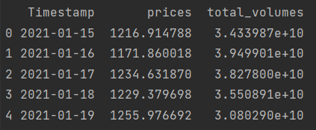
Coingecko Scrapping
After some transformations in Python, this is the result for Ethereum for a given time range:

Slide 11
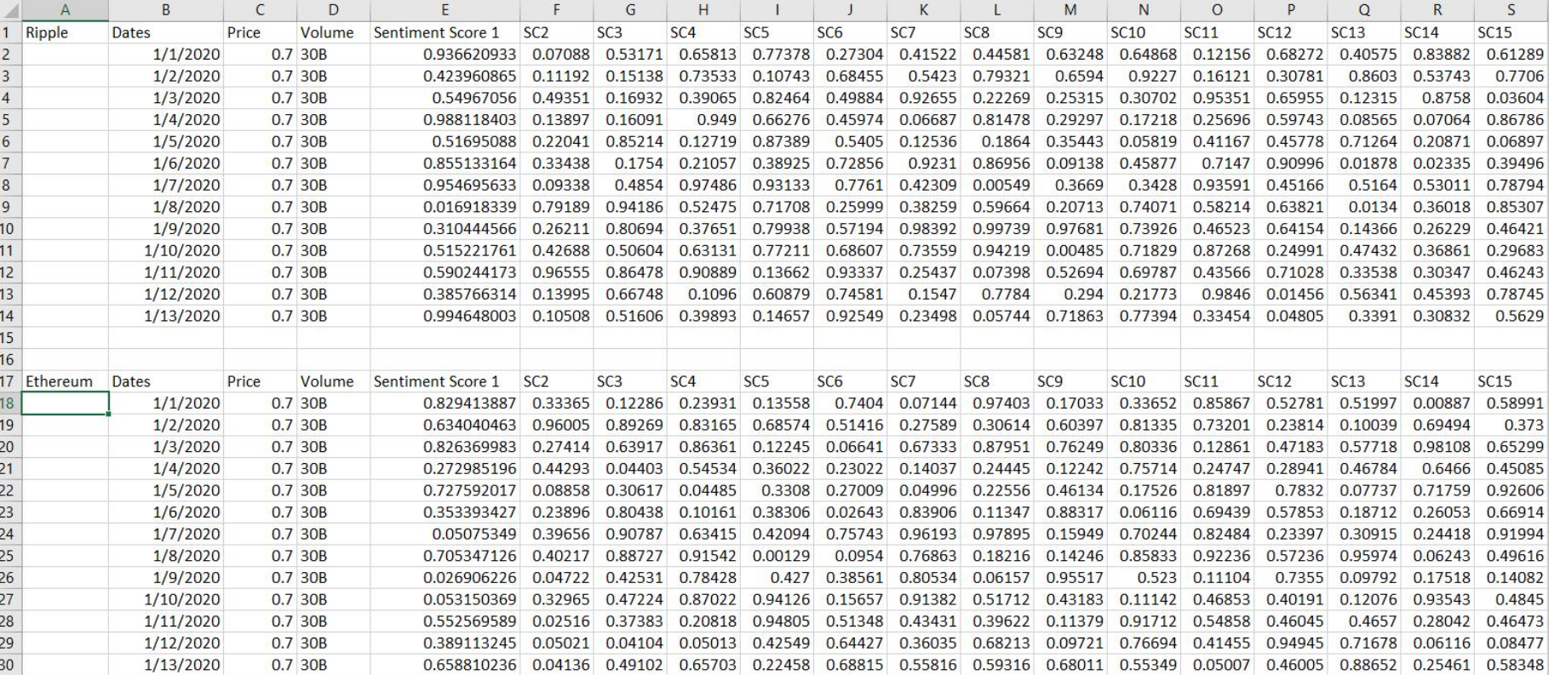
Mergin Prices and Sentimen Scores – table “Z”

Slide 12
Development - Phase 3 (training model)
→ Splitting of the dataset “Z” into training and test sets (we save the test prices (20%) and empty them to optimize the training)
→ Training of the neural network (LSTM)for price prediction with “Z_train” and “Z_test”

Slide 13
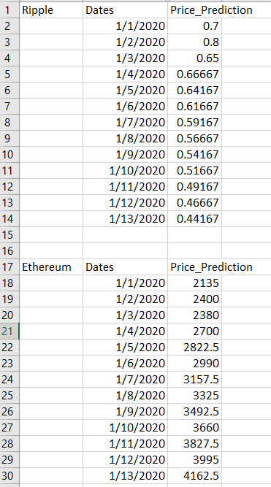
Price prediction with lstm

Slide 14
Development - Phase 4 (new sentiments)
→ Scrapping news from multiple sources through Cryptopanic
→ Pass these news on a daily basis through the GPT-2 sentiment analyzer and obtain their scores
→ Merge these scores with its corresponding new market data on a daily basis, obtaining new dataframes called “A+”

Slide 15
Development - Phase 5 (Model Predictions)
→ Feed the already trained LSTMneural net with “A+” dataframe in order for it to make the prices predictions
→ Predictions will be for the following weeks and months prices.
→ Establishing the cryptocurrencies asset allocation on Enzyme based on these predictions

Slide 16
Tools
→ Python 3.8
→ Libraries: Pycoingecko, Pandas, transformers, requirements.xt (from Reddit scrapper)
→ Github
→ Enzyme

